Slide 1
An Adaptive Steganography Scheme for Voice over IP
Hui Tian ; Ke Zhou ; Hong Jiang ; Yongfeng Huang ; Jin Liu ; Dan Feng
Circuits and Systems, 2009. ISCAS 2009. IEEE International Symposium on

Slide 2
Outline
Introduction
Background and definition
The Adaptive steganography scheme
Evaluation and test
Conclusion
References

Slide 3
Introduction
Recently, steganography has drawn increasing attention. Many different steganographic methods for storage media have been proposed in the last few years.
Voice over IP (VoIP), as a possible carrier to apply steganography to provide security for secret messages.

Slide 4
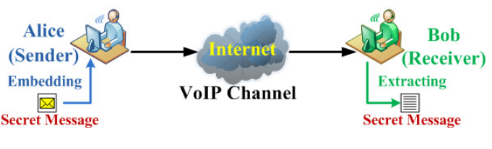
Background and definition
The framework of VoIP steganography
LSB(Least Significant bit)
PSV (Partial Similarity Value)

Slide 5
Background and definition(cont.)
Definition 1 (VoIP Steganography):
Given the quadruple Ø = <C, M, D, E>,
where C is the set of VoIP packet (VoIP stream),
M is the set of secret messages with |C| ≥ |M|,
E: C × M → C represents the embedding function and D: C → M represents the restituting function.
A system with the property that D(E(c, m)) = m for ∀ c ∈C and m ∈M is called a VoIP steganography system .

Slide 6
Background and definition(cont.)
Definition 2 (Similarity Function):
Let C be a non-empty set. A function sim: C 2 → (- ∞ ,1] is called the similarity function on C, for x , y ∈C, if x = y, sim(x, y) = 1; otherwise, sim(x, y) < 1.
Further, the transparency criterion for steganography can be formally described that for ∀ c ∈C and m ∈M maximizing the value of the following function:
f(c, m)=sim(c, E(c,m)) - 1

Slide 7
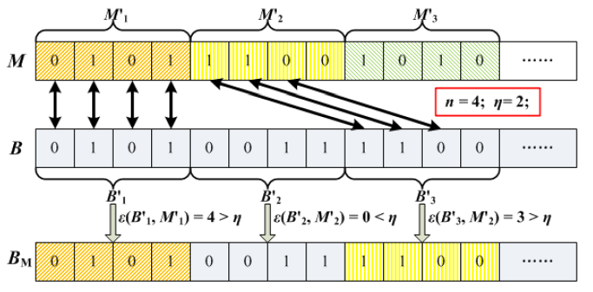
The Adaptive steganography scheme
The adpative embedding process

Slide 8
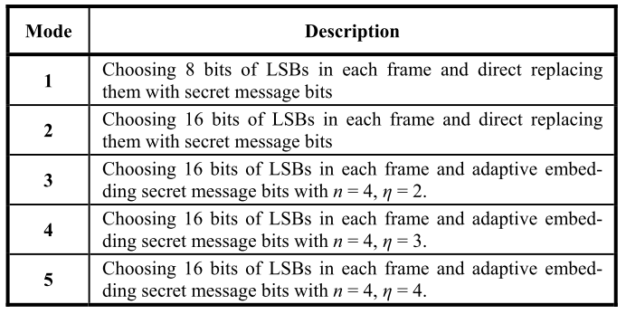
Evaluation and test
STEGANOGRAPHY MODES

Slide 9
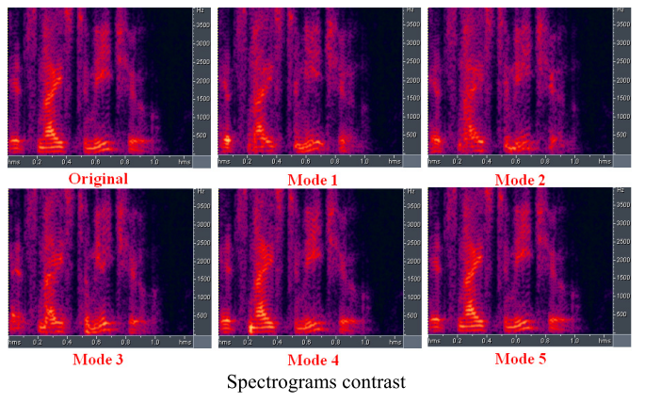
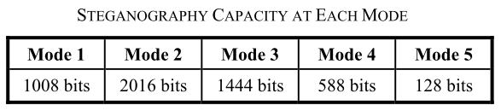
Evaluation and test(cont.)
Test One

Slide 10
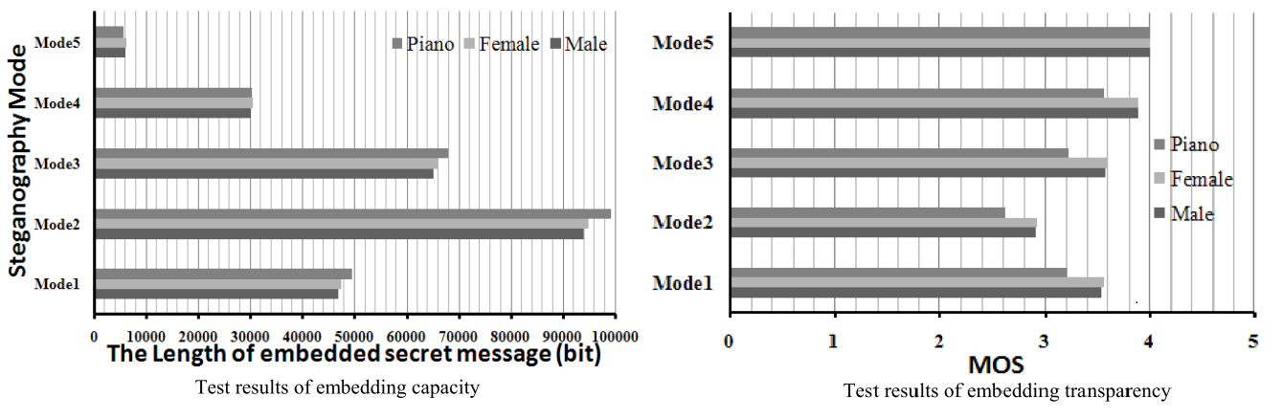
Evaluation and test(cont.)
Test Two

Slide 11
Conclusion
In this paper, we proposed an adaptive steganography scheme for VoIP. The salient advantage of this scheme is that it can adaptively balance the embedding transparency and capacity. Moreover, experimental results demonstrate that our method outperforms the traditional LSBs substitution method.

Slide 12
References
Hui Tian ; Ke Zhou ; Hong Jiang ; Yongfeng Huang ; Jin Liu ; Dan Feng, An Adaptive Steganography Scheme for Voice over IP, Circuits and Systems, 2009. ISCAS 2009. IEEE International Symposium on

